Slide 1

SUPPORT VECTOR MACHINES: INTUITION
Assume that you are data scientist working at a major bank in NYC.
You want to classify a new client as eligible to retire or not, customer features are: Age and Savings.
SUPPORT VECTORS
FEATURE #2: SAVINGS
MAXIMUM MARGIN
MAX MARGIN
HYPERPLANE
FEATURE #1: AGE

Slide 2



SUPPORT VECTOR MACHINES: INTUITION
FEATURE #2
FEATURE #1

Slide 3
SUPPORT VECTOR MACHINES: MODEL EVALUATION
TRAINED MODEL
(MAX MARGIN
HYPERPLANE)
FEATURE #2
TESTING DATASET
FEATURE #1

Slide 4
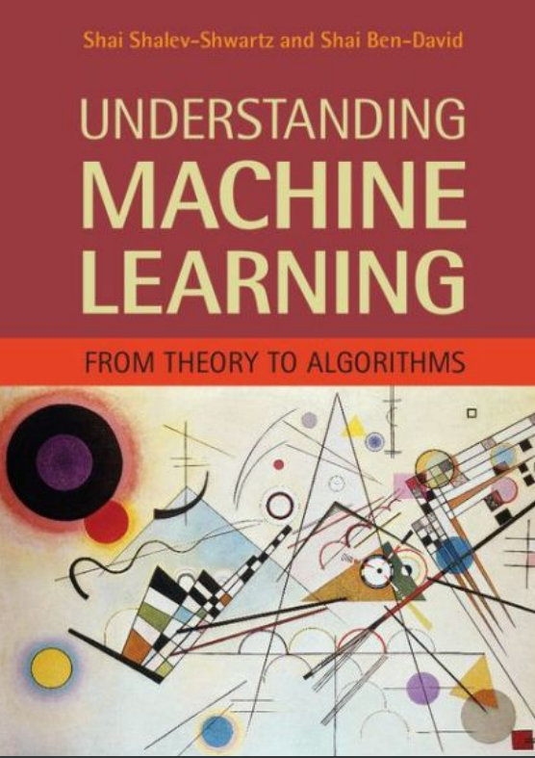
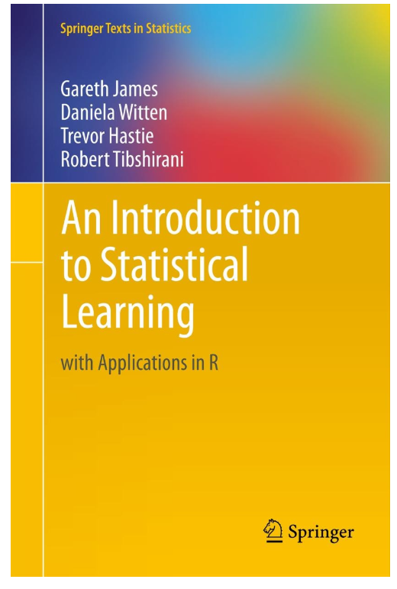
SUPPORT VECTOR MACHINES: ADDITIONAL READING MATERIAL
Additional Resources, Page #202: http://www.cs.huji.ac.il/~shais/UnderstandingMachineLearning/understanding-machine-learning-theory-algorithms.pdf
Additional Resources, Page #337:
http://www-bcf.usc.edu/~gareth/ISL/ISLR%20Seventh%20Printing.pdf

